Slide 1


Slide 2

Computer Science Project I
CS 691
Team Name: Technocrats
Team 1

Slide 3

AGENDA
Measuring our progress towards our deadlines, coordinating our activities, addressing any difficulties, and resolving on the next steps as they apply
to improvement are the highest priorities of this session.
01
02
Trying to keep track on significant dates. Add activities to a group calendar. Mention regarding timely submission.
03
Analyse and research all the components that our project would require
from the client's point of view.
For something like the project to be effective, it needs to have interaction, attendance, cooperation, teamwork, as well as attention from each team
member.
04

Slide 4
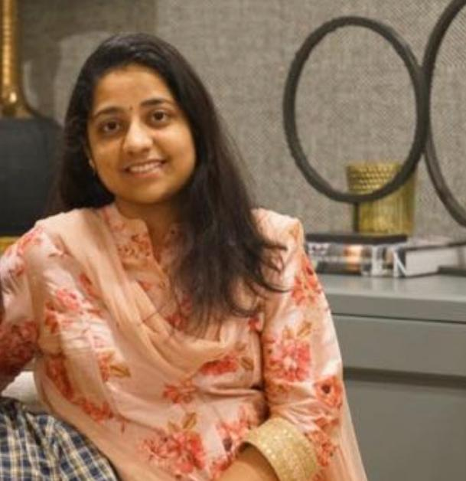
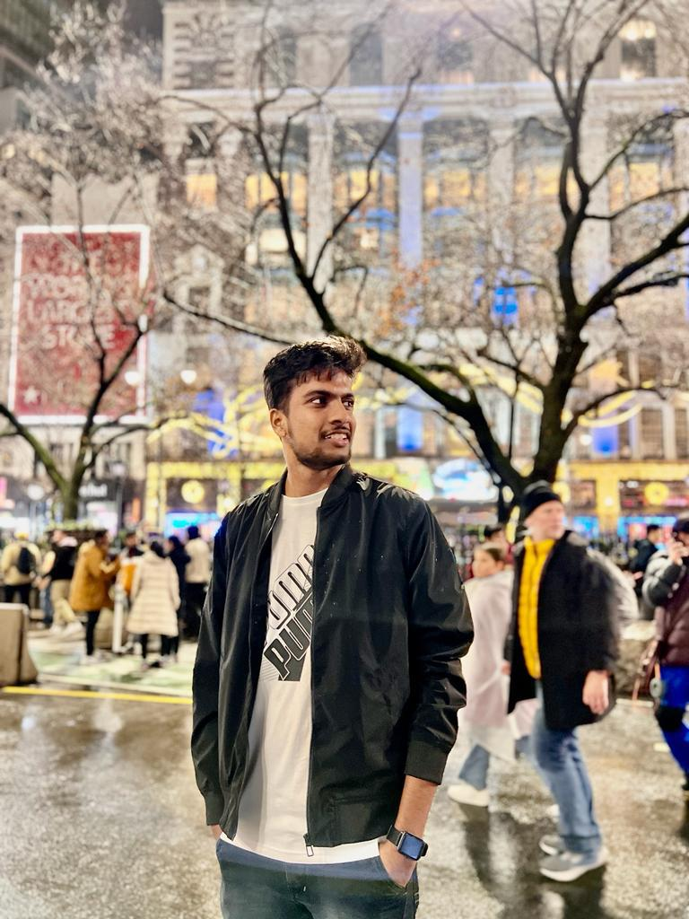
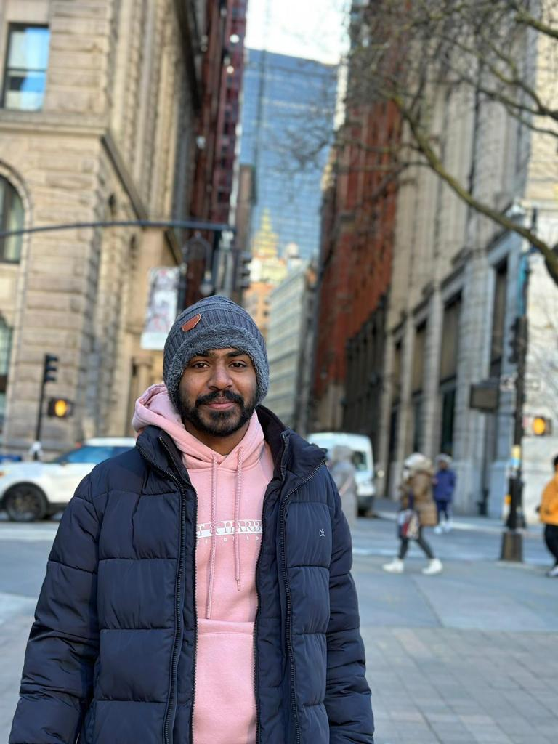
TEAM MEMBER ROLES
Sai Sindhu
Developer
Anil Babu
Developer
Anivi Reddy
Developer

Slide 5



TEAM MEMBER ROLES
Sahith
Quality
Analyst/Tester
NIKHIL
Scrum master &
QUALITY ANALYST
Bharadwaja
Developer

Slide 6
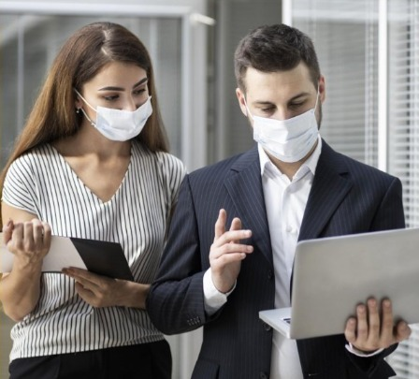
IMPROVEMENTS MADE FROM PROFESSOR'S FEEDBACK
Professor provided inputs after the delivery of
Deliverable 2, recommending us to improve its
conceptual architecture diagram. The following
slides highlight the changes we made to our sprint plan by taking professor feedback into consideration and
also suggested to use the task in our product backlogs
its issue type and also create tables in slides instead of using screenshots.

Slide 7

PROBLEM STATEMENT
Over the last two years, Social Distancing has become increasingly prevalent as a part of the Covid-19 pandemic outbreak. According to international health authorities, interpersonal communication is the principal primary contributor to the pandemic's spread. To avoid the spreading, it is therefore necessary to maintain the necessary spacing with some effort. In addition, developing an
automated Contact Detection step that secures privacy would be beneficial to prevent further infection. Today's smartphones are not just for communication; they can also detect numerous characteristics of their environment (movement, proximity, orientation, etc.). In addition, now a days practically everyone utilizes a smartphone. Reflect on these facts The issue is resolved by a mobile app that can notify users when it detects that a person is approaching from a closer distance than is advised.

Slide 8
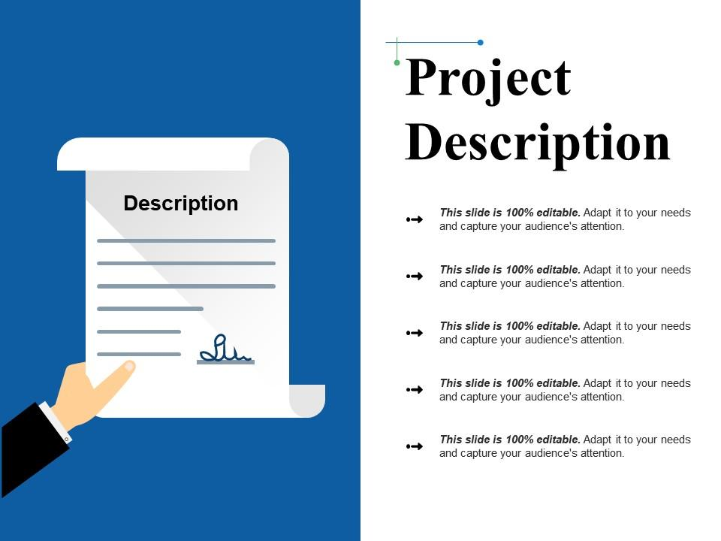
PROJECT DESCRIPTION
Our product is focused on COVID-19 safety Protocols. It is designed to ensure that people are adhering to social distancing guidelines. Ultimately, it can help make people and the community safer from the virus . This is a tracking app that uses a smartphone's GPS and Bluetooth features to track COVID-19 case. Bluetooth technology enables users to assess their risk of being exposed to the COVID-19 virus if they have been within six feet of a confirmed case. It is also able to detect specific locations that are deemed 'infected area’s through location data analysis, and crowd sourcing. this data so it is easily accessible for decision making purpose. The idea behind the app was to make people aware of their risk, and give them the tools to protect themselves from contracting the virus. We developed a product that would be a cost-effective measure for protecting profits and human life. The idea for our product is based on the idea of a "control" to prevent COVID-19 from spreading. It would be an app that uses Bluetooth and GPS capabilities to track COVID-19 cases and would also provide alerts in case it detects COVID-19 in an area. This product was designed to be inexpensive, effective, providing information necessary for the public's awareness of where the virus is being spread. We designed this app as incentive to prevent someone from spreading the virus as they are able to see how close they are getting near people who have contacted it.

Slide 9

PERSONAS

Slide 10

PERSONA 1
About
Christiana is a student who is pursuing her masters in a public university.
Goals
In the process of going to the college she will travel a lot and meet lot of random people who might got affected
by covid virus.so ,she want to be careful for which she need
to protect herself form covid and covid patients she use our
app which was built for covid detection of covid effected
persons nearby distances of 6ft with the help of location and Bluetooth tools .she gets notification that she was in danger zone that someone near to her is effected by covid in 6ft
distance.so that she can take precautions. Like maintain
proper social distances.
Profile
Name: Christiana
Age: 24
Location: New York, NY
Job: Student
Family: Lives with her boyfriend

Slide 11

PERSONA 2
About
Maddy is a senior nurse she will makes regular bp and
temperature of the patients.
Goals
Maddy, a nurse in a public hospital, is often overwhelmed with multiple patients. It would be immensely useful if she had a
mobile application that could detect who is within 6ft of her
location. This would make her job much easier and safer. Both
scenarios will require Maddy to do a set of certain tasks for the app to perform its intended action. For the scenario, she must create an account, install and activate her mobile application, use the app at work for it to detect where she is within 6ft of her current location. Maddy must store her account information, so the app can detect
where she is within 6ft of her current location.
Profile
Name: Maddy
Age: 35
Location: New Jersey, NJ
Job: Senior nurse
Salary: $74000/year
Family: Husband

Slide 12
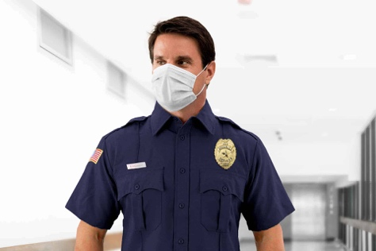
PERSONA 3
About
Sourabh was a chief security officer at a shopping complex who checks every customer at the entrances of the mall.
Goals
Sourabh goal is to check each and everything of every single customer whether they are healthy or got effected by
the covid. Through our app he gets the notification when any
persons effected by the covid is near to him in 6 ft distances.
so then he stops them and take the measures to get them the
prescribed quarantine so that the other people in the mall
doesn’t get effected.
Profile
Name: Sourabh
Age: 44
Location: Alabama, Ga
Job: Chief Security Officer
Salary: $112000/year
Family: Two children and wife

Slide 13

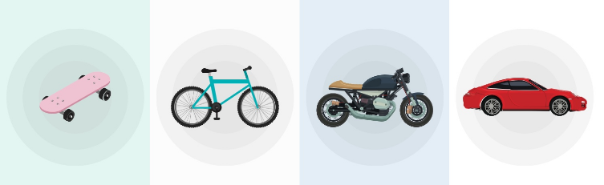
MINIMAL VIABLE PRODUCT (MVP)

Slide 14
MINIMAL VIABLE PRODUCT (MVP)
The Following are the Features we are covering in our MVP
Login Page
Registration Page
Home Page
Play and Pause buttons to start the Scanning of surrounding areas
Alerts to the users
Users previous Covid19 history

Slide 15







JENNA DOE
TECHNOLOGIES

Slide 16
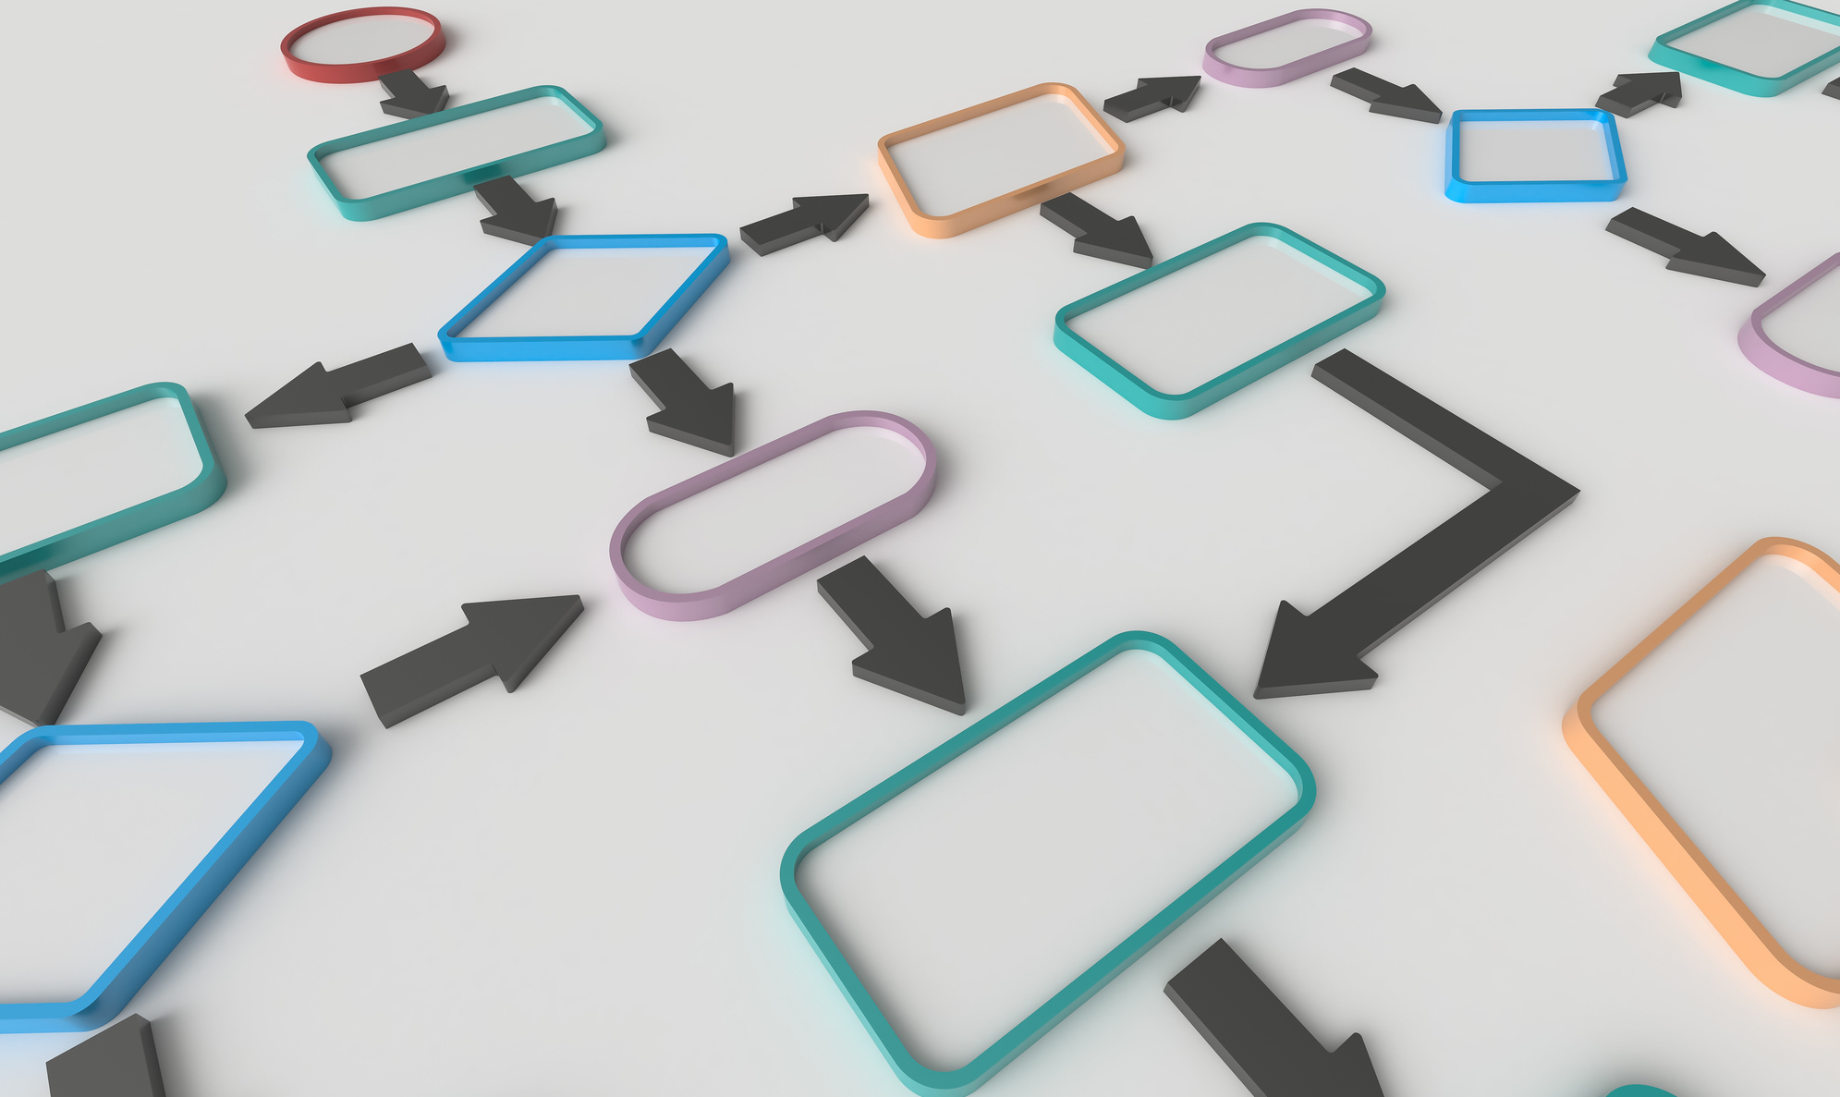
ARCHITECTURE DIAGRAM

Slide 17










CONCEPTUAL ARCHITECTURE DIAGRAM
How does it works?
3 Proximity is classified
Using Bluetooth RSSI
values
2 Exchange anonymous
Bluetooth beacons that
contains a unique key
Covid-19 infected person
contact
1 User installs and start the armor app
6ft
Tested positive
Users are alerted!
If recommended
distance is not
maintained
4 Each user save local
anonymous
Data about people
whom they encountered.
5 infected users will update
their status as positive for
covid-19 in the app
If there is a matching
result in the local database,
user will receive a notification
6 The app regularly downloads the
database of infected users and
crosscheck for matching keys in the local database
Anonymous keys of infected
users are uploaded to
a centralized cloud database

Slide 18
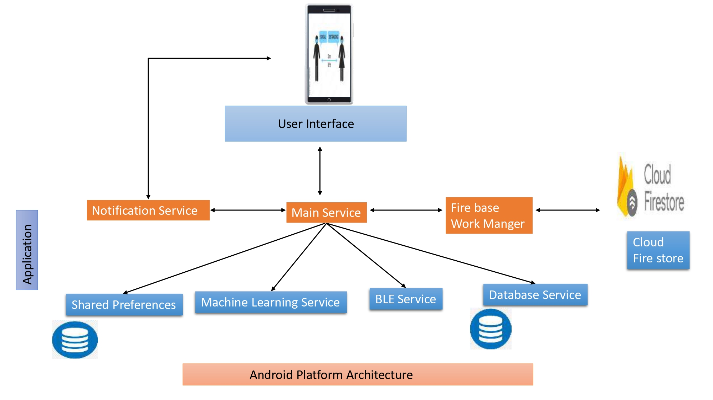
SEQUENCE ARCHITECTURE DIAGRAM

Slide 19
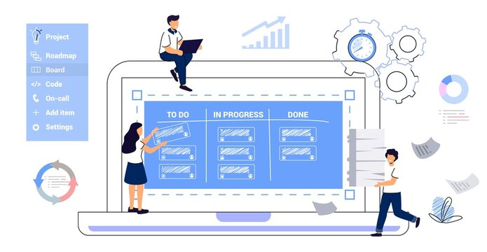
PRODUCT BACKLOG

Slide 20
COMPETITIVE ADVANTAGE
PRODUCT BACKLOG
ID | Summary | Status
Cov-1 | To gather all the requirements for the project. | Done
Cov-2 | As a team we should have team work agreement with all rules and regulations. | Done
Cov-3 | As a team we should divide roles and responsibilities among ourselves to develop the project. | Done
Cov-4 | As a team we should develop required technical and functional knowledge required to complete the project. | Done
Cov-5 | As a team we should plan the product requirements and development plan for the project. | Done
Cov-6 | As a user I should have a Apk file which can be installed in mobile with basic functionalities. | Done
Cov-7 | As a user I should be able to see the welcome page for Application. | Done
Cov-8 | As a user I should be able to see the Knowledge page after welcome page , which has information of how application works. | Done
Cov-9 | As a user I should be able to give all the required permissions to application to access the required data in mobile. | Done
Cov-10 | As a user I should be able to reset the permissions for application anytime. | Done

Slide 21
THEM
COMPETITIVE ADVANTAGE
US
PRODUCT BACKLOG
ID | Summary | Status
Cov-11 | As a user I should be able to see the Registration page for the application. | Done
Cov-12 | As a user I should be able to the user name and get registered in the application. | Done
Cov-13 | As a user I should be able to get pop up notification to turn on Bluetooth if application is being used. | Done
Cov-14 | As a user I should be able to get pop up notification, asking required permissions for the application | Done
Cov-15 | As a registered user I should be able to see the home page, once I login in to the application. | Done
Cov-16 | As a registered user I want to logout from the application so that I can log in again whenever I want. | Done
Cov-17 | As a user, I want to create my account to the application so that I can Keep my account private and Signup Using Name, Email and Password. | Done
Cov-18 | As a user, I want to login using my email id as my user id so that I can access my account | Done
Cov-19 | As a user, I want to navigate between pages so that I can quickly access the features I need | Done
Cov-20 | As a user, I want to access the feature in home page | Done
Mercury is the closest planet to the Sun and the smallest one in the Solar System—it’s only a bit larger than the Moon
Venus has a beautiful name and is the second planet from the Sun. It’s terribly hot—even hotter than Mercury

Slide 22
PRODUCT BACKLOG
ID | Summary | Status
Cov-21 | As a registered user I want to see the play the button in the Bluetooth screen page so that I can start searching for infected users near my location. | To be Done
Cov-22 | As a registered user I want to see the pause button in the Bluetooth screen page so that I can stop scanning for infected users in the application. | To be Done
Cov-23 | As a registered user I want to see the option for changing the user’s name in settings page so that I can change the user’s name. | To be Done
Cov-24 | As a registered user I want to see the option for marking as covid 19 infected person in settings page so that I can update my status whenever I diagnosed with covid. | To be Done
Cov-25 | As a registered user I want to see the option for deleting my account in settings page so that I can delete my account. | To be Done

Slide 23
SOLUTION
ACCEPTANCE CRITERIA TABLE
ID | Scenario | Summary | Place
Cov-16 | User opens application after installation | Given I'm a user of the application When I click on the settings icon in the application Then I should be able to see the logout option And When I click on the logout, I should be able to logout from the application. | Logout
Cov-17 | User want to create account | Given I’m in a role of the user, trying to create my account to the application When I open the app Then the app asks me to sign up or login And I click on the signup, I should able to create my account to the application using Name, Email and Password. | Sign Up

Slide 24
SOLUTION
ACCEPTANCE CRITERIA TABLE(continued)
ID | Scenario | Summary | Place
Cov-18 | As a registered user I should be able to login using Email id as user id | Given I’m the user of the application When I open the app, I should be able to see the apps login page. Then I should be able to enter my registered email id in the user id or email field and password in password field. And after entering the details I should be able to login or sign in. If my credentials are valid, I should be able to access my account If my credentials are invalid, I should see an error indicating that the credentials are incorrect. And then I should be able to reset my password if I forget it or need to update it. | Login
Cov-19 | As a user I want to be able to easily navigate between different pages so that I can quickly access the features I need | Given I’m the user of the application When I open the app, I want the navigation menu to be clearly labelled and organised so that I can easily find the pages I need to use Then I want the navigation menu to be optimized for smaller screens so that I can easily access the pages I need on my phone or tablet And as a user I want the navigation menu to include a search bar so that I can quickly find the pages I need by keyword search. | Home page

Slide 25
SWOT ANALYSIS
ACCEPTANCE CRITERIA TABLE(continued)
ID | Scenario | Summary | Place
Cov-20 | As a user I want to be able to access the features in home page | Given I’m the user of the application When I open the app, I should be able to access the features in the home page Then I open the app home page should be intuitive and easy to navigate And as a mobile user I want the home page to be responsive and optimized for my device | Home Page
S
W
O
T
STRENGTHS
WEAKNESSES

Slide 26
TEST CASES
ID | Unit of Test | Scenario | Test Data | Steps to be Expected | Expected Result
Cov-16 | Logout | Successful Logout | Email –example@example.com, Password: test123 | Homepage ->Logout | When the user click on the settings icon in the application user should be able to see the logout option in the menu
Cov-16 | Logout | Successful Logout | Email – email@email.com Password – Email@99 | Homepage ->Logout | When the user click on the logout option user should be able to logout from the application without any error.
Cov-17 | Sign Up | Sign Up should be Successful | Name – Sai Email - example@example.com, Password: test123 | Homepage ->Sign Up | Check result on Entering valid Name, Email and Password
Cov-17 | Sign Up | It should show an error as “Email is already in use” | Name – Anil Email – email@email.com Password – Email@99 | Homepage ->Sign Up | Check result email entering already used
Cov-17 | Sign Up | It should show an error “Enter the password with given parameters” | Name – Anivi Email – password@mail.com Password – Password@14 | Homepage ->Sign Up | Check the response did the password is containing all the parameters

Slide 27
TEST CASES(continued)
ID | Unit of Test | Scenario | Test Data | Steps to be Expected | Expected Result
Cov-18 | Login | Successful Login | Email – example@example.com, Password – test123 | Homepage -> Login | User should be successfully logged in and redirected to the relevant page or dashboard.
Cov-18 | Login | Invalid Email ID | invalid email, Password: test123 | Homepage -> Login | User should see an error message indicating that the email ID is invalid and should be prompted to enter a valid email ID.
Cov-18 | Login | Invalid Password | example@example.com, Password – invalid password | Homepage -> Login | User should see an error message indicating that the password is incorrect and should be prompted to enter the correct password.
Cov-18 | Login | Forgot Password | Click on "Forgot Password" link | Homepage -> Login | User should be redirected to the password reset page where they can enter their registered email ID to reset their password.
Cov-18 | Login | Account Lockout | Enter incorrect password multiple times | Homepage -> Login | User's account should be temporarily locked after a certain number of failed logins attempts to protect against brute force attacks.
Cov-18 | Login | Logout | Click on "Logout" or "Sign Out" option | Homepage -> Login | User should be successfully logged out of their account and redirected to the login page.

Slide 28
TEST CASES(continued)
ID | Unit of Test | Scenario | Test Data | Steps to be Expected | Expected Result
Cov-19 | Home page | Open the home page | Verify that all features listed in the home page are visible and displayed correctly. | Login-> Home page | All features listed in the home page should be visible and displayed correctly.
Cov-19 | Home page | Click on each feature listed in the home page. | Verify that each feature is accessible and functional. | Login->Home page | All features listed in the home page should be accessible and functional.
Cov-19 | Home page | Open the home page on a mobile device. | Verify that the home page is responsive and optimized for the mobile device | Login->Home page | The home page should be responsive and optimized for the mobile device.
Cov-19 | Home Page | Verify that the navigation menu is visible and clearly labelled on every page of the application. | Open the application and navigate to a page. Verify that the navigation menu is visible. Verify that the labels of the menu items are clear and descriptive. | Login-> Home Page | The navigation menu is visible and clearly labelled.

Slide 29
TEST CASES(continued)
ID | Unit of Test | Scenario | Test Data | Steps to be Expected | Expected Result
Cov-20 | Home Page | Verify that the navigation menu is organized and structured logically | Open the application and navigate to the home page. Verify that the navigation menu items are organized in a logical manner. Verify that related pages are grouped together. | Login-> Home Page | The navigation menu is organized and structured logically.
Cov-20 | Home Page | Verify that the navigation menu is optimized for smaller screens. | Open the application on a mobile device. Verify that the navigation menu is collapsed and can be expanded with a tap. Verify that the menu items are clearly visible and easy to tap on. | Login-> Home Page | The navigation menu is optimized for smaller screens.
Cov-20 | Home Page | Verify that the navigation menu includes a search bar. | Open the application and navigate to the home page. Verify that the navigation menu includes a search bar. Type a search term into the search bar. | Login-> Home Page | The navigation menu includes a search bar and search results are relevant.

Slide 30

SWOT ANALYSIS
S
W
O
SPRINT
BACKLOG
WEAKNESSES
STRENGTHS
Venus has a beautiful name, but it’s hot
Jupiter is the biggest planet in the Solar System

Slide 31
SPRINT 3 BACKLOG
SPRINT 3
ID | Summary | Status | Place
Cov-16 | As a registered user I want to logout from the application so that I can log in again whenever I want. | To be done | Logout
Cov-17 | As a user, I want to create my account to the application so that I can Keep my account private and Signup Using Name, Email and Password. | To be done | Sign Up
Cov-18 | As a user, I want to login using my email id as my user id so that I can access my account | To be done | Login
Cov-19 | As a user, I want to navigate between pages so that I can quickly access the features I need | To be done | Home Page
Cov-20 | As a user, I want to access the feature in home page | To be done | Home Page

Slide 32
SPRINT 4 BACKLOG
SPRINT 4
ID | Summary | Status | Place
Cov-21 | As a registered user I want to see the play the button in the Bluetooth screen page so that I can start searching for infected users near my location. | To be Done | Home page
Cov-22 | As a registered user I want to see the pause button in the Bluetooth screen page so that I can stop scanning for infected users in the application. | To be Done | Home page
Cov-23 | As a registered user I want to see the option for changing the user’s name in settings page so that I can change the user’s name. | To be Done | Home page
Cov-24 | As a registered user I want to see the option for marking as covid 19 infected person in settings page so that I can update my status whenever I diagnosed with covid. | To be Done | Home page
Cov-25 | As a registered user I want to see the option for deleting my account in settings page so that I can delete my account. | To be Done | Home Page

Slide 33
Stories Completed in Sprint 3
ID | Summary | Status | Place
Cov-16 | As a registered user I want to logout from the application so that I can log in again whenever I want. | Done | Logout
Cov-17 | As a user, I want to create my account to the application so that I can Keep my account private and Signup Using Name, Email and Password. | Done | Sign Up
Cov-18 | As a user, I want to login using my email id as my user id so that I can access my account | Done | Login
Cov-19 | As a user, I want to navigate between pages so that I can quickly access the features I need | Done | Home page
Cov-20 | As a user, I want to access the feature in home page | Done | Home Page

Slide 34

METRICS

Slide 35
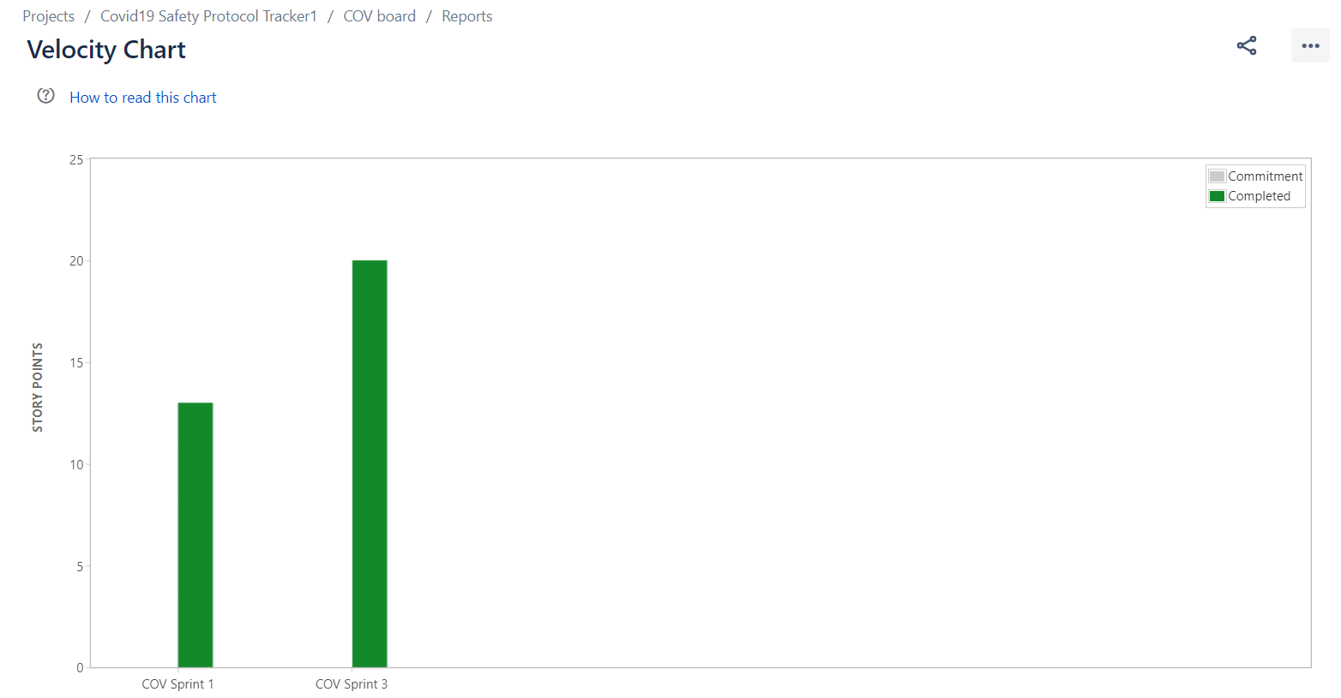
METRICS
VELOCITY REPORT

Slide 36
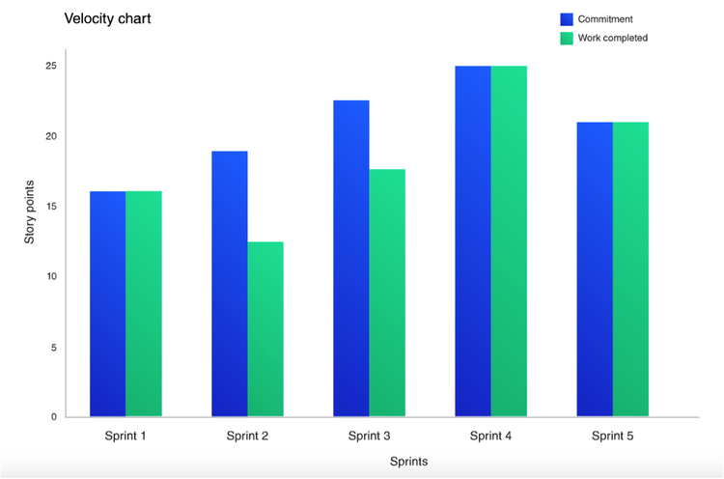

TEAM MEMBERS VELOCITY REPORT
METRICS

Slide 37
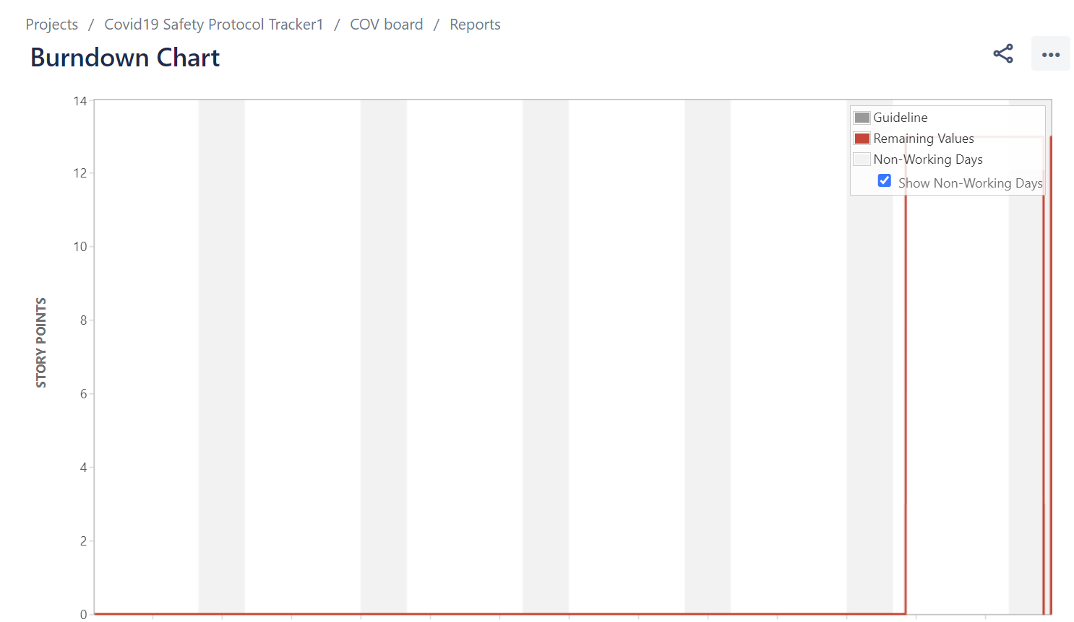
METRICS
SPRINT BURNDOWN CHART

Slide 38
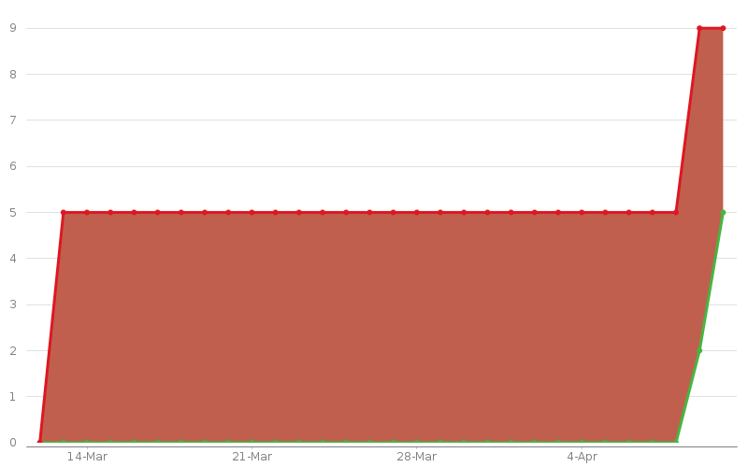
Created vs Resolved Issues Report
METRICS
COMPLELETED vs COMMITTED RATIO
Project: Covid19 Safety Protocol Tracker1
Chart
This chart shows the number of issues created vs the number of issues resolved in the last 30 days.

Slide 39
RETROSPECTIVE
As we are using Microsoft Teams for daily communication
and for team meetings, Communication went in a well
organized way.
What went well
Team members should not miss the weekly meetings also they
should make sure to give updates to their teammates about the
work they do.
What needs improvement
In the next sprint we should make sure that everyone of the
team should be responsible to complete the work assigned to
them.
Next Steps

Slide 40
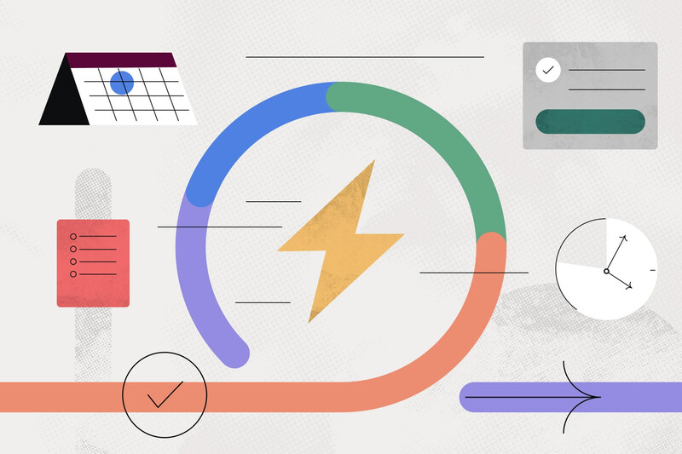
SPRINT 4

Slide 41
Stories planned for SPRINT 4
ID | Summary | Status | Place
Cov-21 | As a registered user I want to see the play the button in the Bluetooth screen page so that I can start searching for infected users near my location. | To be Done | Home page
Cov-22 | As a registered user I want to see the pause button in the Bluetooth screen page so that I can stop scanning for infected users in the application. | To be Done | Home page
Cov-23 | As a registered user I want to see the option for changing the user’s name in settings page so that I can change the user’s name. | To be Done | Home page
Cov-24 | As a registered user I want to see the option for marking as covid 19 infected person in settings page so that I can update my status whenever I diagnosed with covid. | To be Done | Home page
Cov-25 | As a registered user I want to see the option for deleting my account in settings page so that I can delete my account. | To be Done | Home Page

Slide 42

PROJECT DEMO SPRINT 3

Slide 43
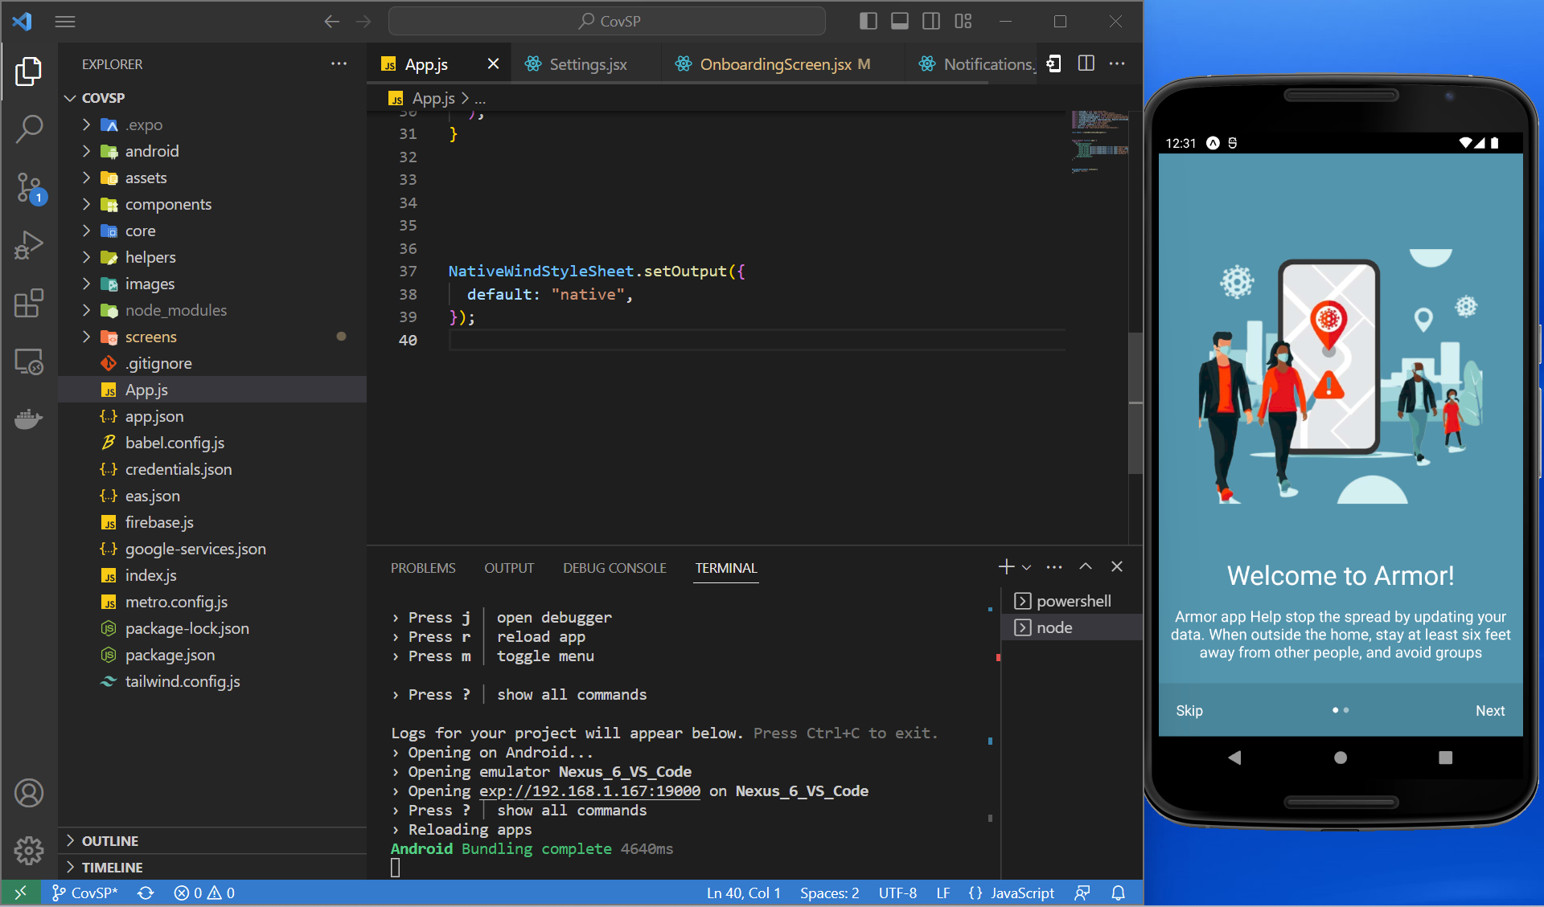
PROJECT DEMO SPRINT 3
Live application demo:

Slide 44
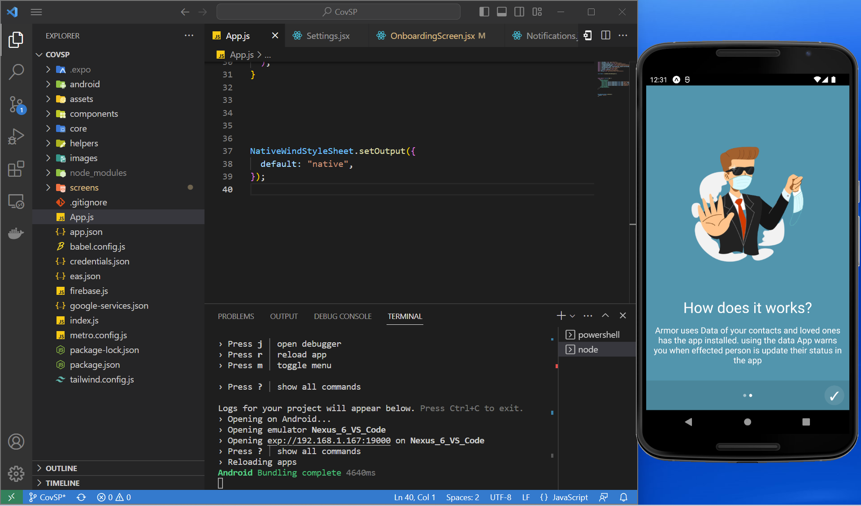
PROJECT DEMO SPRINT 3
Onboarding Screen

Slide 45
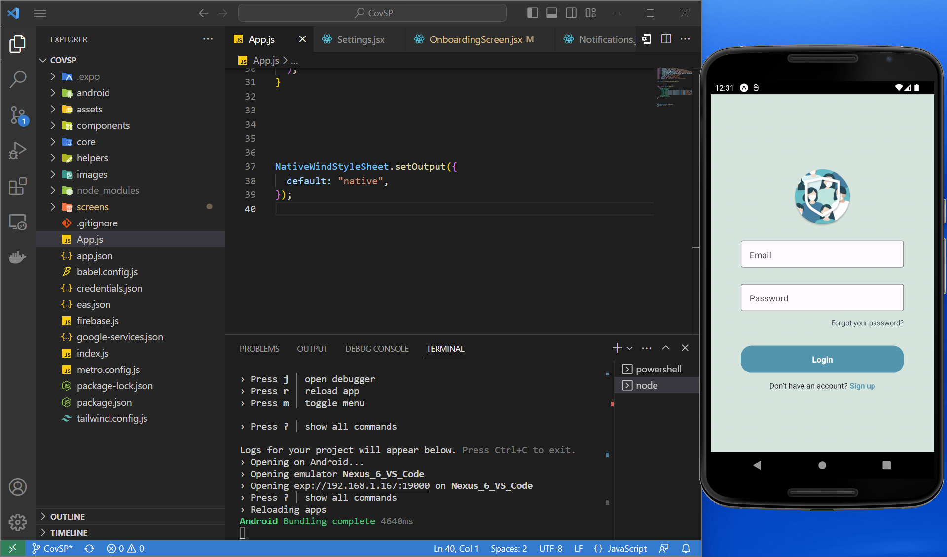
PROJECT DEMO SPRINT 3
Login Page

Slide 46
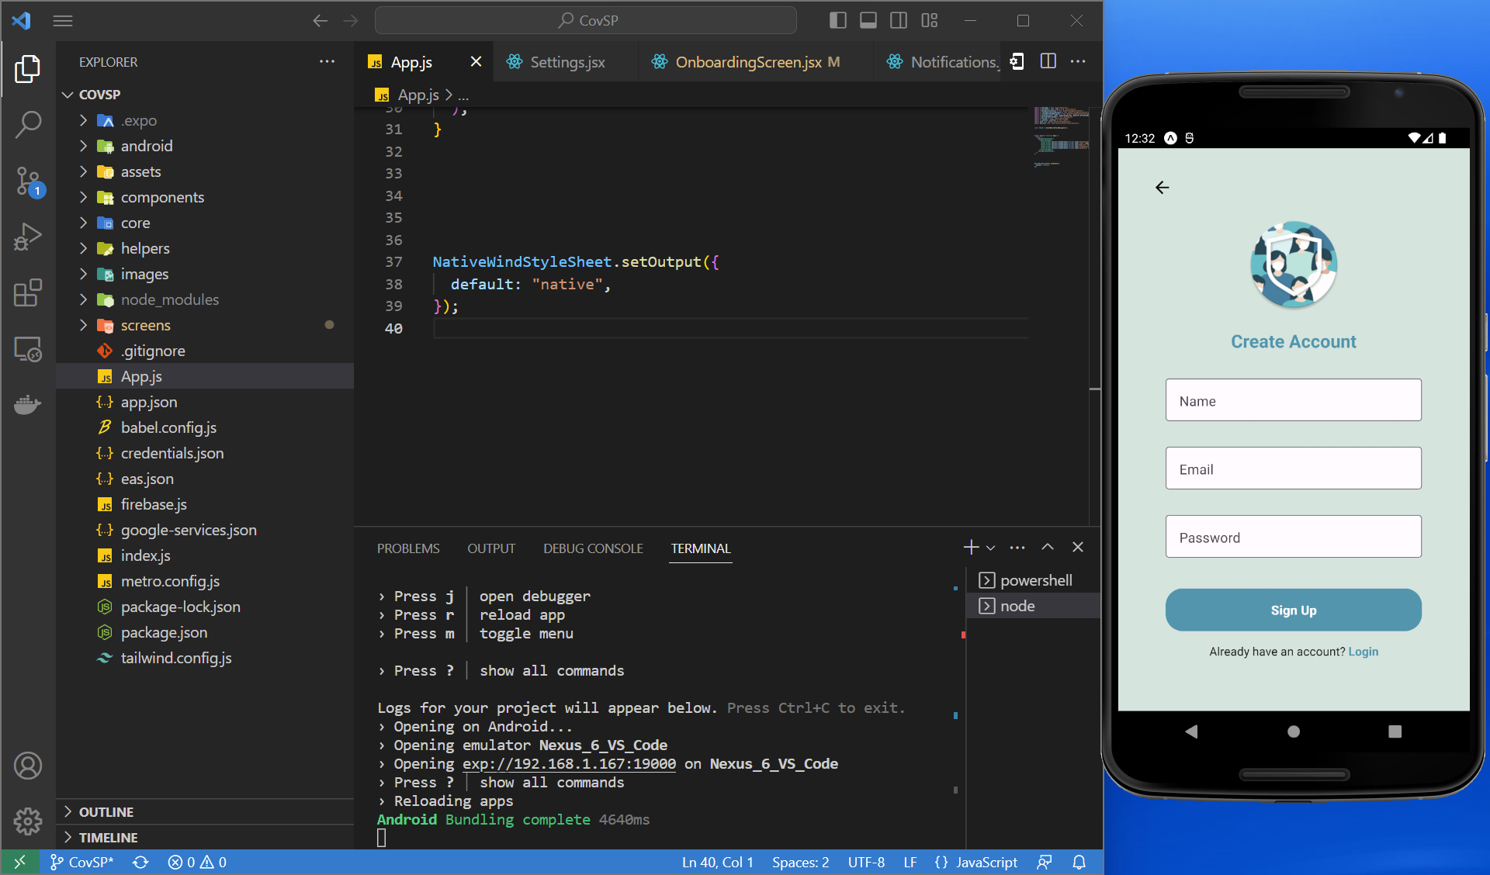
PROJECT DEMO SPRINT 3
Registration Page

Slide 47
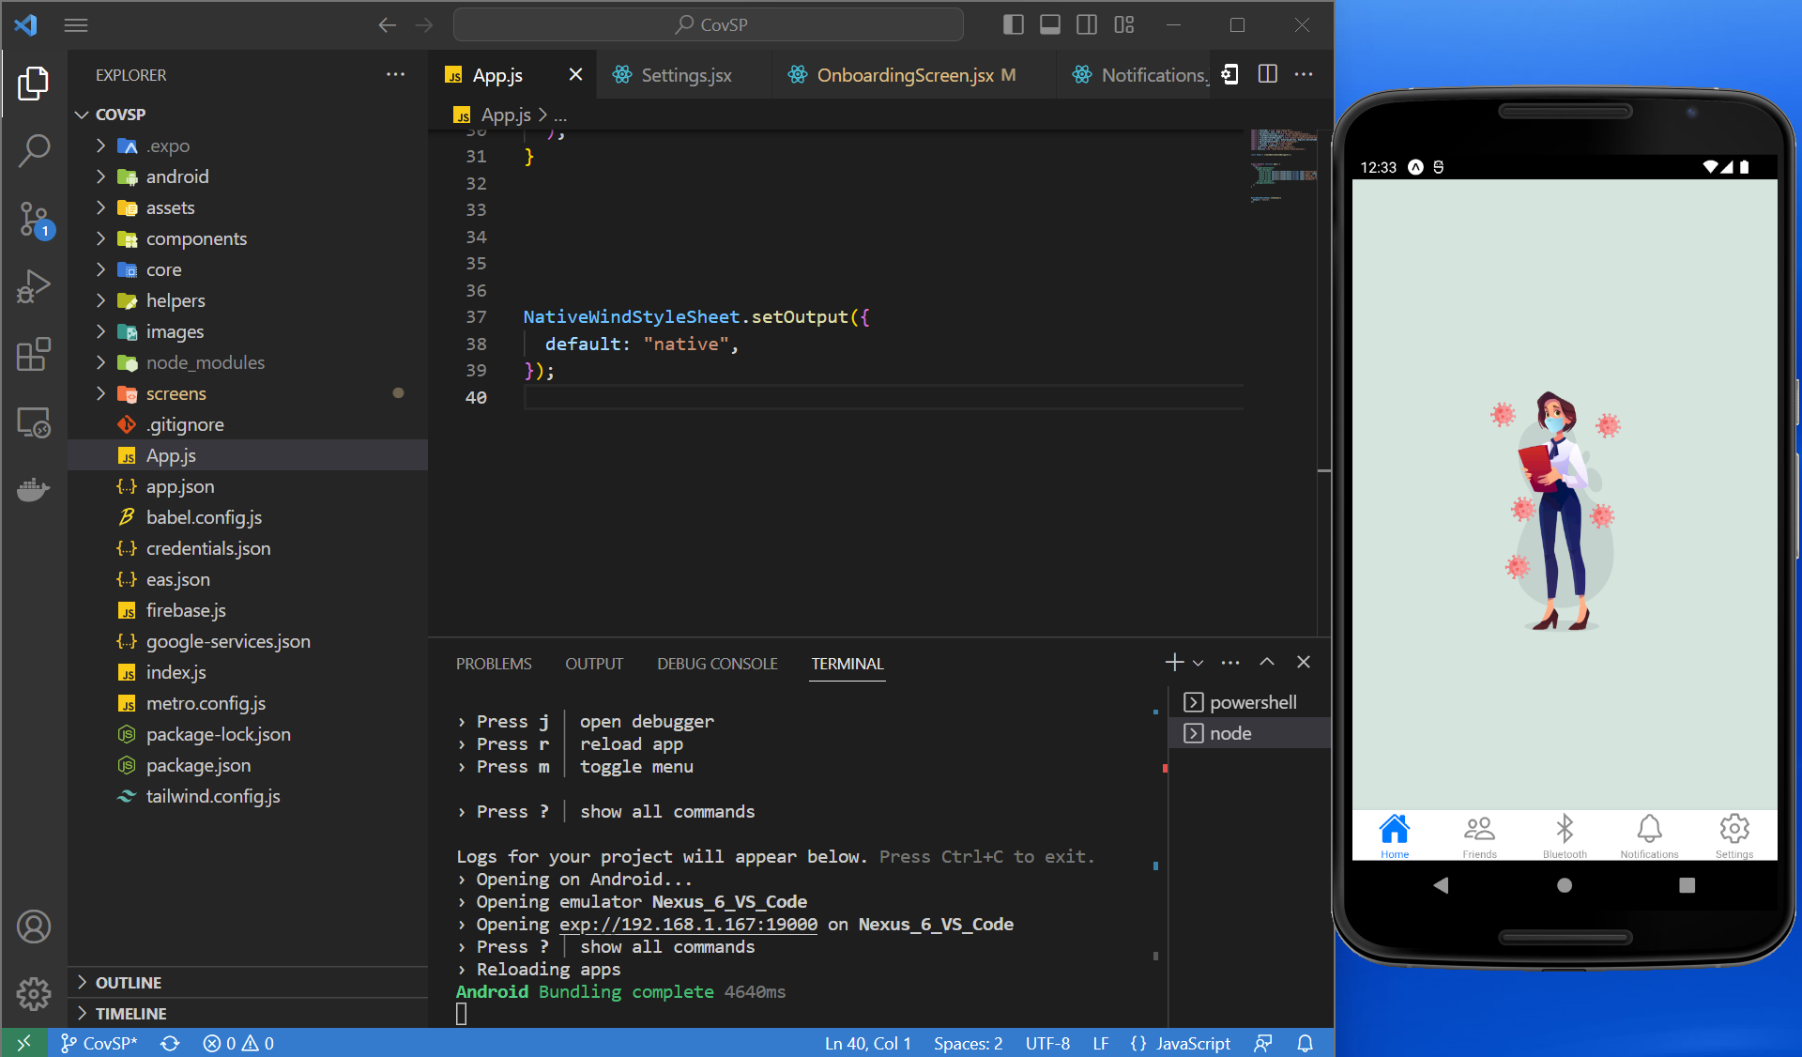
PROJECT DEMO SPRINT 3
Home Page After Login

Slide 48
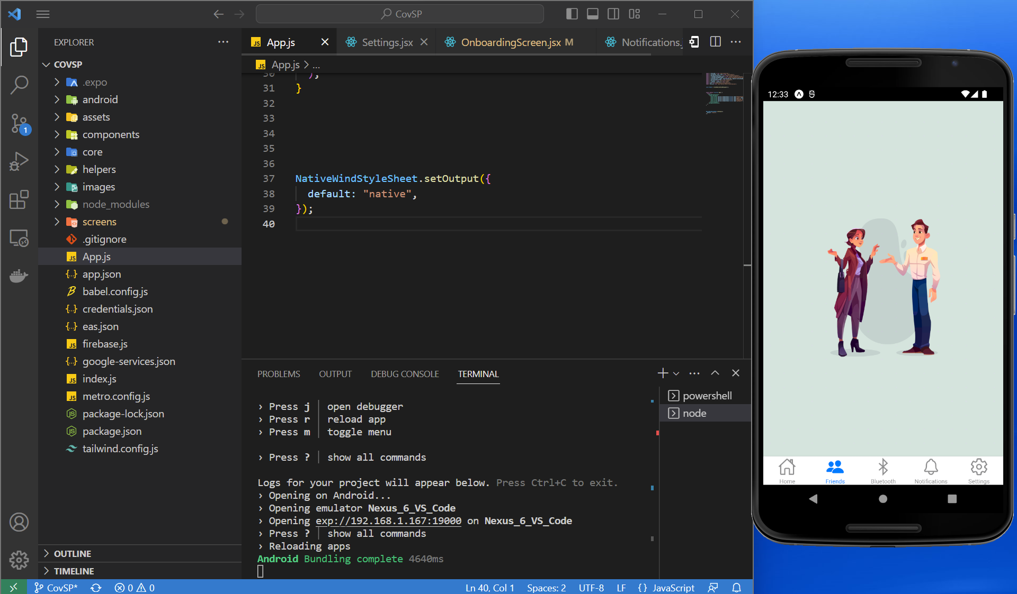
PROJECT DEMO SPRINT 3
Friends Tab

Slide 49
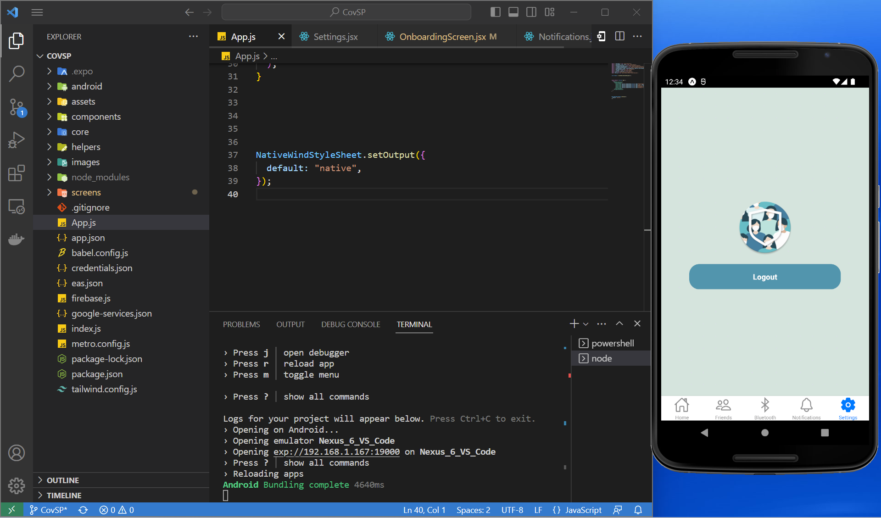
PROJECT DEMO SPRINT 3
Settings tab

Slide 50
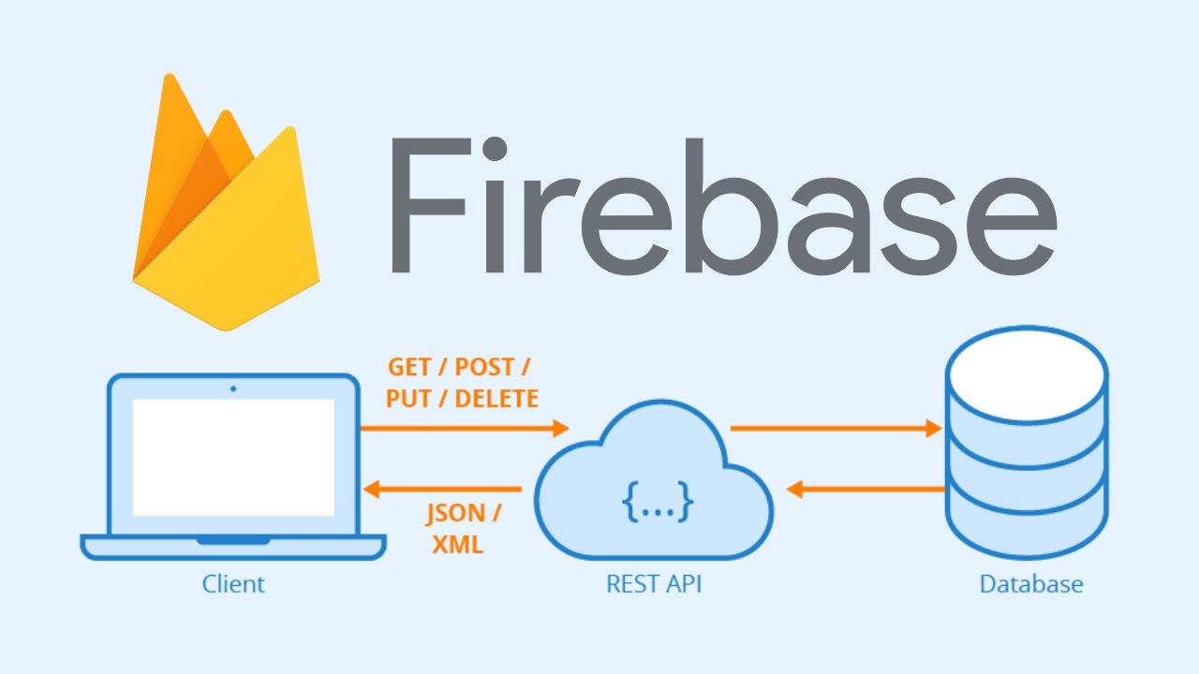
API

Slide 51

GITHUB LINK
https://github.com/htmw/2023S-Team1

Slide 52
THANK YOU

